Slide 1

Copenhagen Airbnb Market Deep-Dive
Analysis of key price drivers & Superhost performance metrics across Copenhagen's primary districts

Slide 2

FEEDBACK ANALYSIS
What drives Airbnb guest feedback?
（A 4-part view of ratings, neighborhoods, price bands, and host quality.
Guest feedback is not only a price or location story. ）

Slide 3
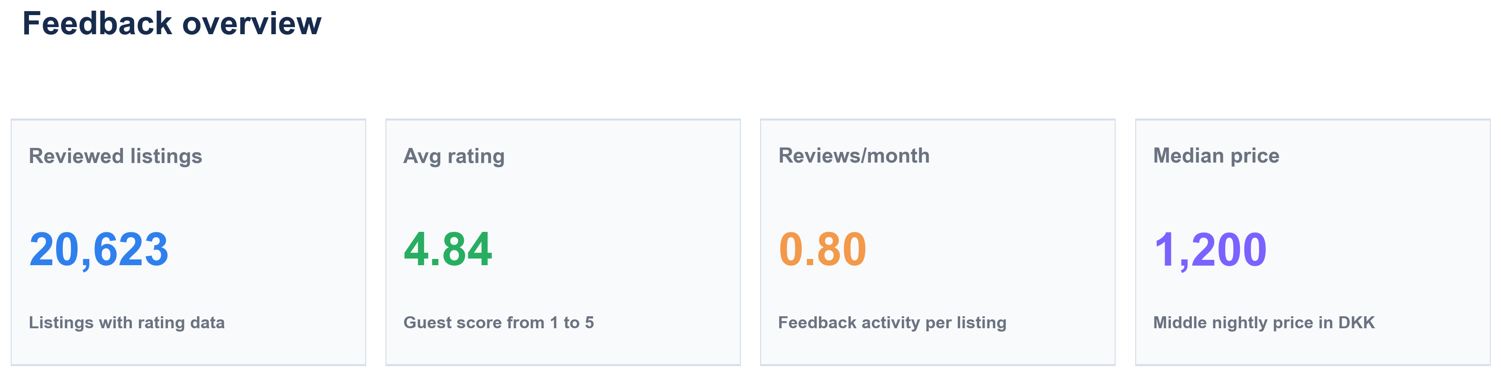
Feedback snapshot: key metrics and definitions 🧐
Key metrics
Average rating: overall guest satisfaction score from 1 to 5.
Reviews/month: average monthly review frequency per listing.
Median price: middle nightly price in DKK; less distorted by extreme prices.
Benchmark lines show overall averages for comparison. Source: data/raw_data/listings.csv.

Slide 4
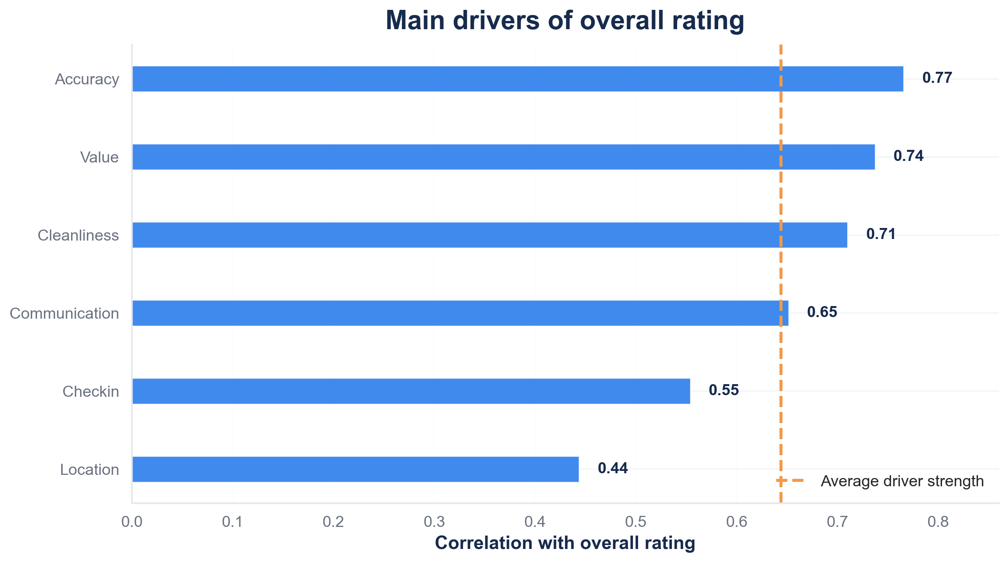
Which factor drives guest ratings? 🤔
QUESTION
Is location the main story behind guest ratings?
NO
Guest ratings are more tied to the stay experience than map position.
1
Accuracy, value, and cleanliness drive rating.
2
Location matters, but only partly.
3
Focus on things hosts can improve, like clean rooms and clear information.
Metric: correlation with overall rating.

Slide 5
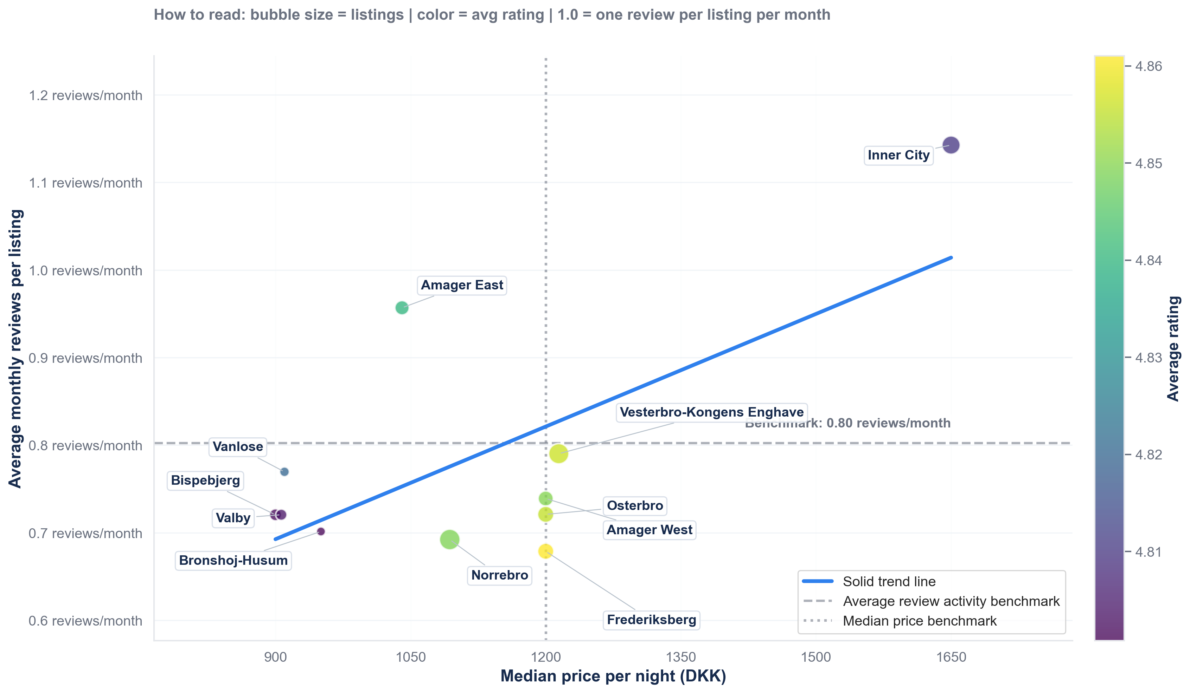
Where Guests Review More vs Rate Higher 🏠
QUESTION
Does the priciest neighborhood always win on feedback?
NO
Price, activity, and rating point to different neighborhood stories.
1
Inner City leads on review activity.
2
Several areas still rate strongly.
3
Look at price, reviews, and ratings together before judging an area.
Axes: monthly reviews/listing vs median nightly price (DKK). Source: listings.csv.

Slide 6
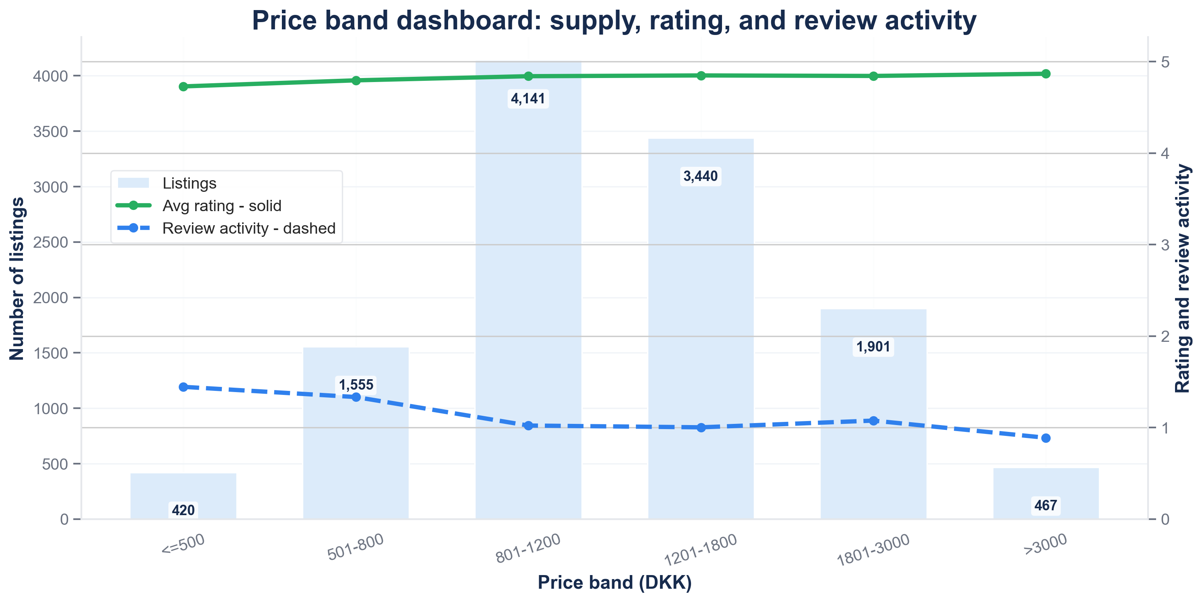
Price alone is not the full feedback story 💰
QUESTION
Does a higher nightly price automatically bring better feedback?
NO
Price helps segment demand, but it does not explain feedback alone.
1
Budget bands get more reviews.
2
Premium bands lift ratings only slightly.
3
Use price groups, but do not assume expensive homes get better reviews.
Bars = listings; solid line = rating; dashed line = review activity.

Slide 7
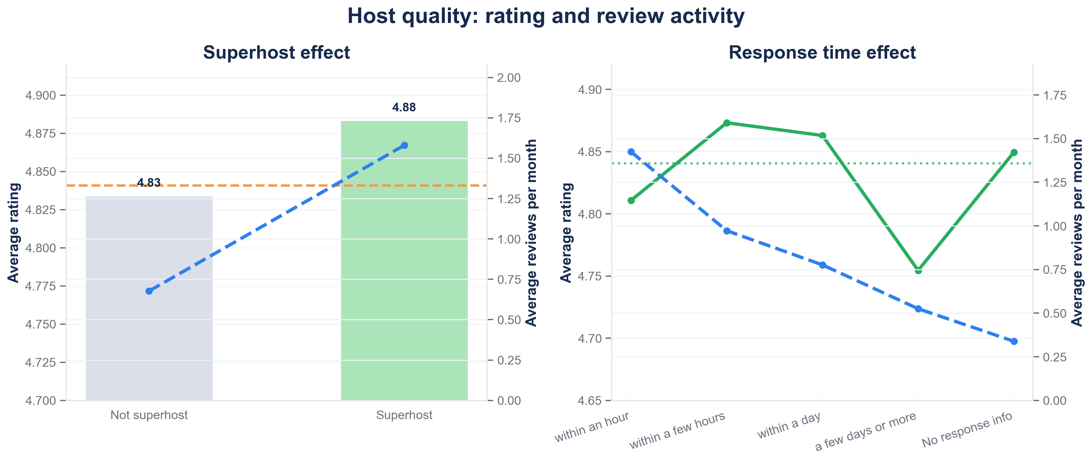
Host quality improves both ratings and review activity 😊
QUESTION
Is feedback only about the apartment itself?
NO
Host operations turn service quality into visible feedback signals.
1
Superhosts rate higher and get more reviews.
2
Slow replies weaken satisfaction.
SUPERHOST SIGNAL
Higher rating + more reviews
RESPONSE SIGNAL
Slow replies weaken satisfaction
3
Good host service, like fast replies, can improve guest feedback.
Comparison: Superhost status and host_response_time.

